Slide 1
Eda case study
Sayan Dutta

Slide 2
Business understanding
A consumer finance company specializes in lending various types of loans to urban customers. When the company receives a loan application, the company has to make a decision for loan approval based on the applicant’s profile.
Two types of risks are associated with the bank’s decision:
1. If the applicant is likely to repay the loan, then not approving the loan results in a loss of business to the company

Slide 3
2. If the applicant is not likely to repay the loan, i.e. he/she is likely to default, then approving the loan may lead to a financial loss for the company The company wants to understand the driving factors (or driver variables) behind loan default, i.e. the variables which are strong indicators of default. The company can utilize this knowledge for its portfolio and risk assessment.

Slide 4
Procedures applied -
Importing Dataset.
Reading the Datasets.
Checking the null values(in the notebook file).
Automated Univariate Analysis(in the notebook file).
Data Imputation(in the notebook file).
Identifying the outliers.
Visualization of selected data.
Correlation o columns of two datasets.
Bivariate & Multi-variate Analysis
Merging two datasets.
Final Analysis.

Slide 5
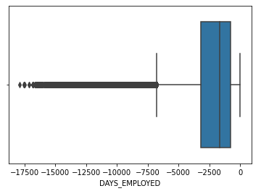
IDENTIFYING THE OUTLIERS
Days_ Employed-As it calculate number of years applicant is employed. Though the data points outside the range are continuous, for loan application, Its feasible to consider till 10000-12000 day(27-35 years of employment), considering more will have effect on repayable capacity of the customer.
Here in Box plot we see some outliers above 12000 days
As per analysis of IQR most of the customer falls between 1000-4000 days(2-8 years) range.

Slide 6
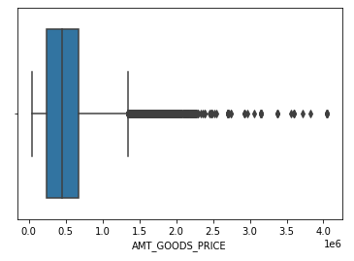
AMT_GOODS_PRICE- It is a price of Consumer goods,and considering consumer loan segment it is important to be prudent for some of the goods that are very high value and are outlier from most of the affluent segment. Consumer goods for which most of loan applicant have applied are in range 250000-70000 and IQR of 441000

Slide 7
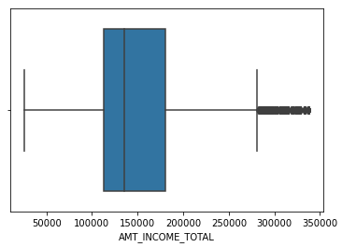
AMT_INCOME_TOTAL- It’s an annual income of the applicant, where we can see some of the outliers. As salary of the applicant can varies depend on their work profile.

Slide 8
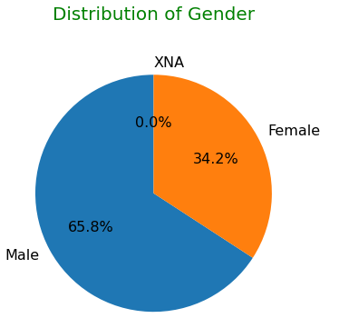
CODE_GENDER - It is the gender classification based on the dataset 65.8% is male, 34.2% is female & 0.0% is xna.

Slide 9
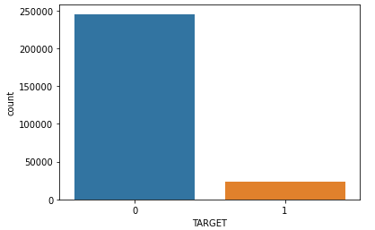
TARGet - Target variable ‘0’ has 91.45% includes all others(repayer) and ‘1’ has 8.54% who have defaulted in some of loan installments . Ratios of imbalance for Repayer Vs Defaulter is 10.70:1 (approx.)

Slide 10
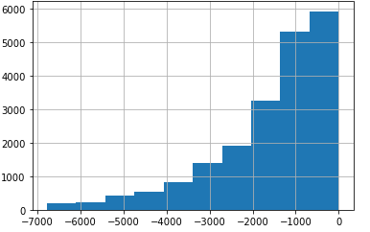
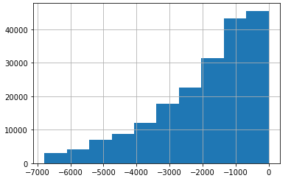
Number of days employed doesn’t effect on whether applicant who are defaulted(Target 1) than who are not (Target 2)
Target defaulter-days employed
Target all others-days employed

Slide 11
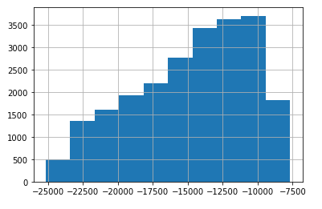
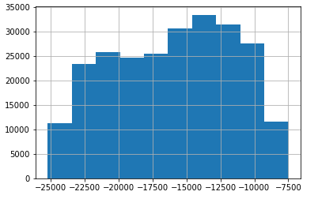
As per Target defaulter, chances of default are more in 25-35 age group. With Analysis of target all others there are only 10% of total applicant who are defaulting as per age group.
Target defaulter-days birth
Target all others-days birth

Slide 12
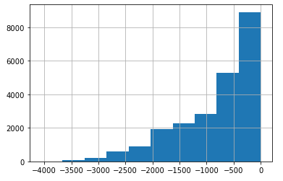
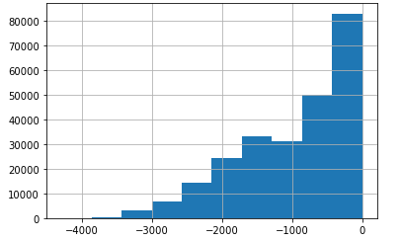
Days of last phone change pattern in both data set are identical and it do not effect on applicant chance on default
Target defaulter-days last phone change
Target all others-days last phone change

Slide 13
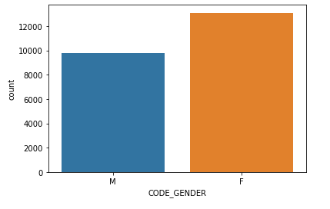
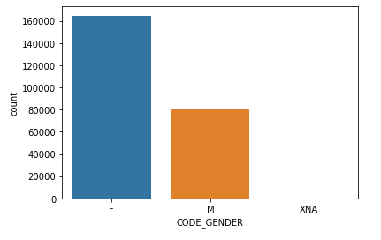
In Target defaulter, most of female are defaulting than male. But when compare to all others in Target 2 ,8-10% are defaulting case than all others
Target defaulter-code gender
Target all others-code gender

Slide 14
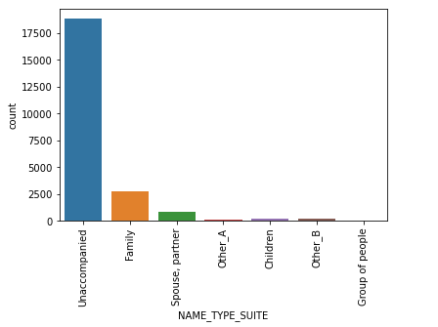
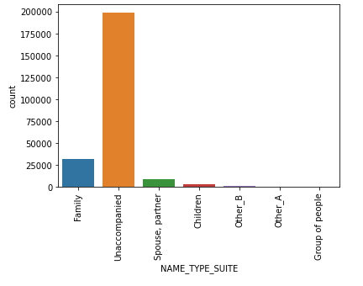
Applicant who are accompained are does not show any indication of default, those who are unaccompanied have higher chance of default
Target defaulter-name type suits
Target all others-name type suits

Slide 15
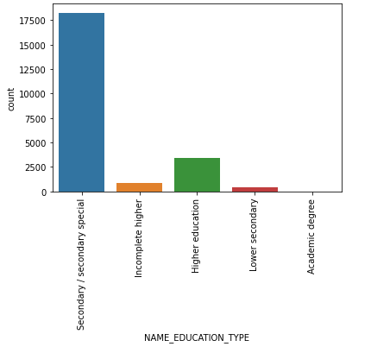
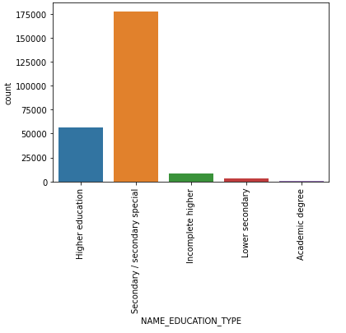
Target defaulter , applicant who are defaulted are 10% of Target all others. Secondary education applicant are higher number of default than compare to others
Target defaulter-name education type
Target all others-name education type

Slide 16
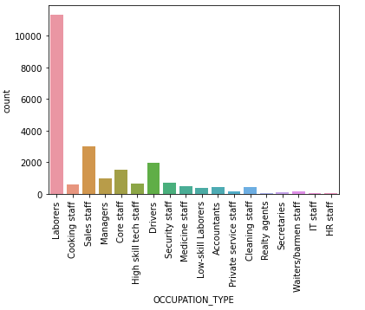
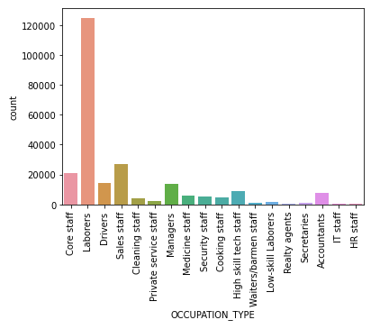
Occupation type – the labourers are above 10000 in the target defaulter followed by sales staff and drivers and so on,whereas in the target all others labourers are again at the top followed by sales staff and managers.
Target defaulter-occupation type
Target all others-occupation type

Slide 17
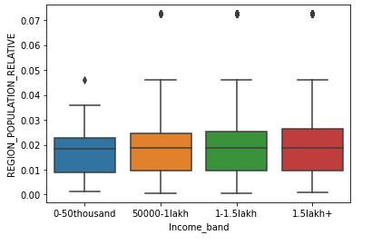
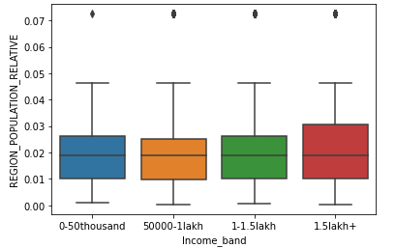
Bivariate analysis of target defaulter and target all others datsaset based on region population relative & income band
Target defaulter
Target all others

Slide 18
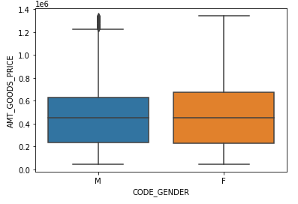
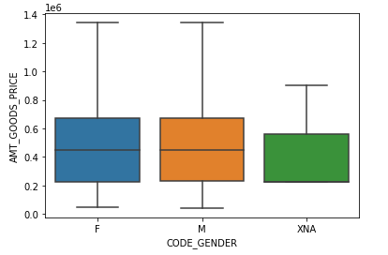
Bivariate analysis of target defaulter and target all others datsaset based on amt_goods_price & code_gender.
Target defaulter
Target all others

Slide 19
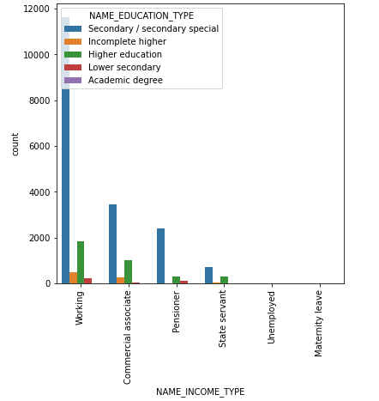
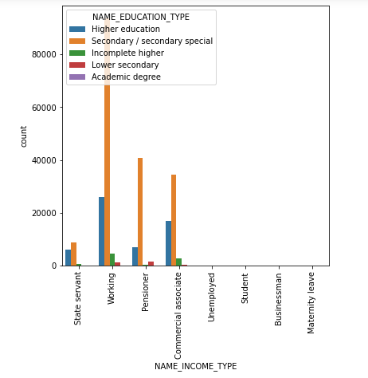
Bivariate analysis of target defaulter and target all others datsaset based on name_education_type & name_occupation_type.
Target defaulter
Target all others

Slide 20
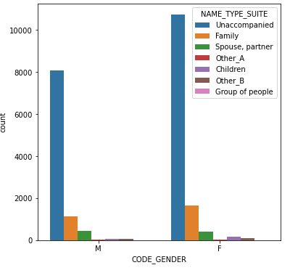
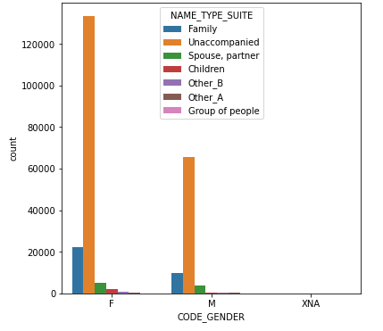
Bivariate analysis of target defaulter and target all others datsaset based on name_type_suite & code_gender.
Target defaulter
Target all others

Slide 21
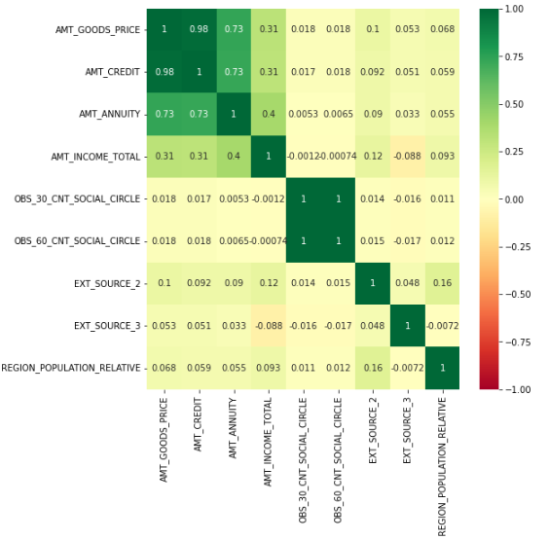
Target defaulter correlation and heatmap – Inferences- Very high correlation between AMT_CREDIT and AMT_GOODS_PRICE . Applicants owning goods of high value can take loans of higher amounts.

Slide 22
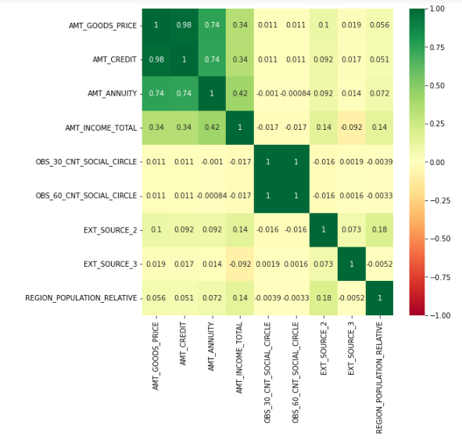
Target all others correlation and heatmap-Very high correlation between AMT_CREDIT and AMT_GOODS_PRICE . Applicants owning goods of high value can take loans of higher amounts.

Slide 23
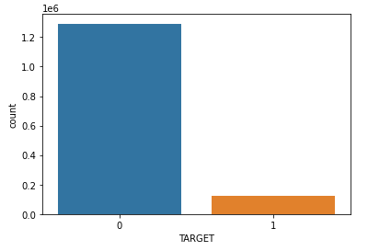
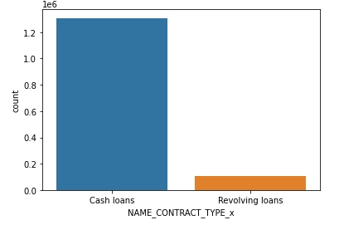
Univariate analysis of the merged dataset
Name_contract_type_x
target

Slide 24
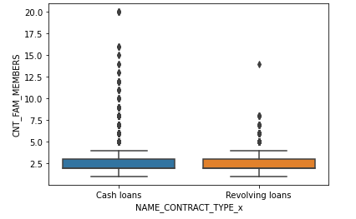
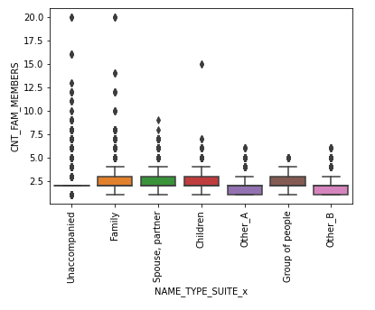
Bivariate analysis of merged dataset.
Cnt_fam_members & name_type_suite_x
Cnt_fam_members & name_contract_type_x-

Slide 25
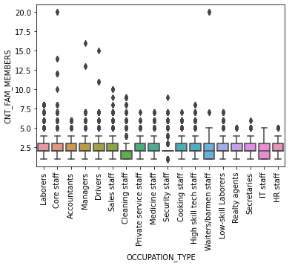
Bivariate analysis of merged dataset based on cnt_fam_members & occupation type.

Slide 26
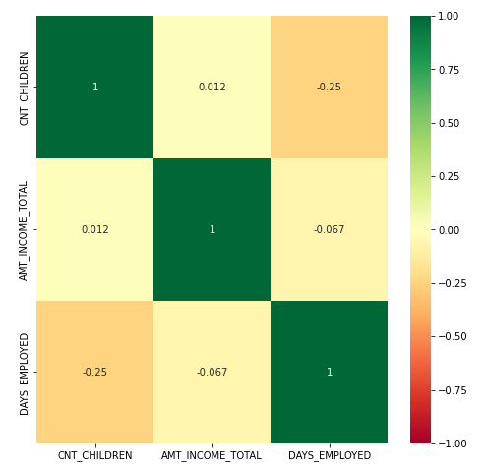
Correlation of the final merged dataset.

Slide 27
Conclusion --
Through this analysis we can conclude that persons with goods price in higher range of 70,000 or above are not likely to be defaulted.
High salary persons are also not to be defaulter.
Number of days employed doesn’t matters much to the defaulter or the repayer group.
As per Target default, chances of default are more in 25-35 age group.
With Analysis of target all others there are only 10% of total applicant who are defaulting as per age group.
Days of last phone change pattern in both data set are identical and it do not effect on applicant chance on default.
In Target defaulter, most of female are defaulting than male. But when compare to target all others ,8-10% are defaulting case than all others.
Applicant who are accompained does not show any indication of default, those who are unaccompanied have higher chance of default.
Target defaulter , applicant who are defaulted are 10% of Target all others. Secondary education applicant are higher number of default than compare to others

